Slide 1
Advanced Topics in Artificial Intelligence
Lecture 1
Anwar Khan

Slide 2
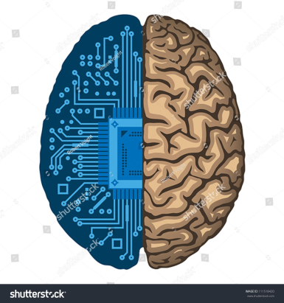
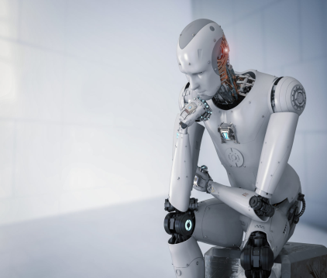
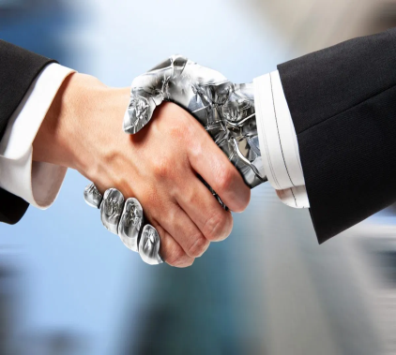
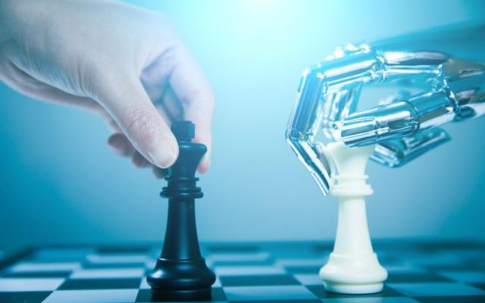
What is AI?
The science of making machines that:
Think like people | Think rationally
Act like people | Act rationally

Slide 3
Acting rationally: rational agent
Rational behavior: doing the right thing
The right thing: that which is expected to maximize goal achievement, given the available information
Notes:
Acting rationally in more general than thinking rationally as in thinking rationally the emphasize is on doing correct inference and one way to act rationally is to reason logically to correct inference. However, correct inference is not all of rationality because there are situations where there is no proven correct thing to do. For example, recoiling from hot stove

Slide 4
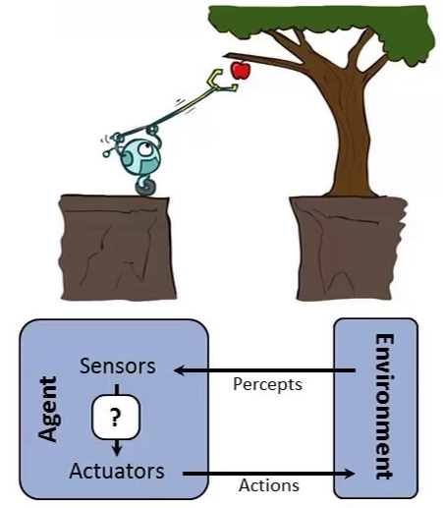
Rational agents
The goal of AI is to build rational agents
An agent is an entity that perceives and acts
An agent is a function from percept histories to actions:
[f: P* → A]
For any given class of environments and tasks, we seek the agent (or class of agents) with the best performance
Notes:
Distinguish between agent and ordinary computer program: Autonomous control, perceiving environment, adapting to changes, being able to take on another goal.

Slide 5
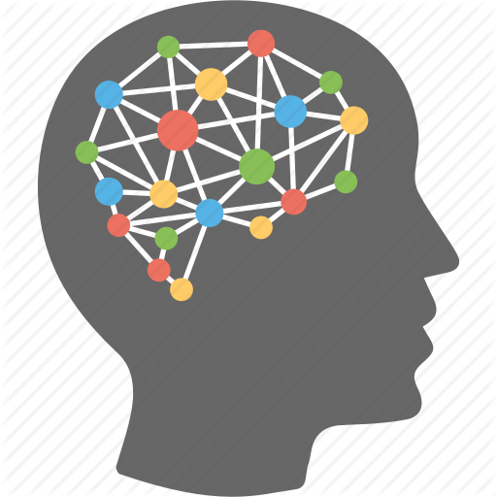
Focus of This Course
Sensors
Environment
Deep Learning/ Neural Networks
Actuators

Slide 6
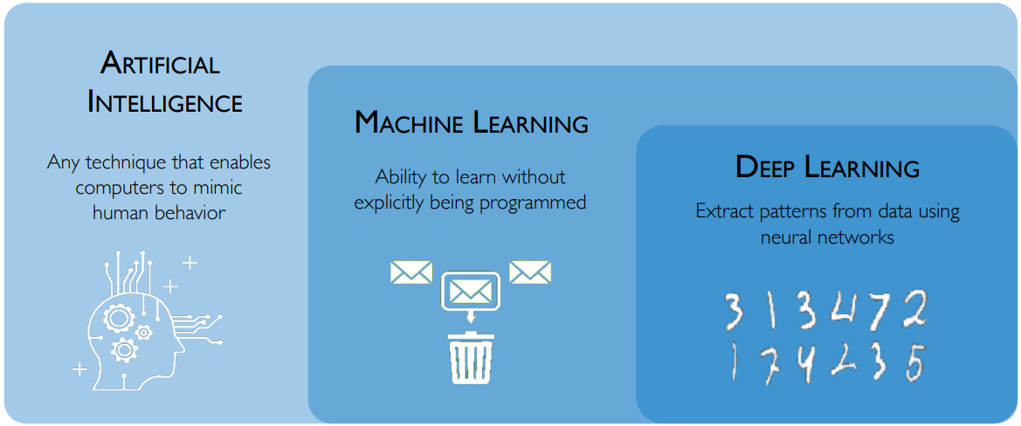
Deep Learning in Artificial Intelligence

Slide 7
A (Short) History of AI
1943 McCulloch & Pitts: Boolean circuit model of brain
1950 Turing's "Computing Machinery and Intelligence"
1956 Dartmouth meeting: "Artificial Intelligence" adopted
1950s Early AI programs, including Samuel's checkers program, Newell & Simon's Logic Theorist, Gelernter's Geometry Engine
1965 Robinson's complete algorithm for logical reasoning
1966—73 AI discovers computational complexity Neural network research almost disappears
1969—79 Early development of knowledge-based systems
1980-- AI becomes an industry
1986-- Neural networks return to popularity
1987-- AI becomes a science
1995-- The emergence of intelligent agents
Notes:
First Work of AI -> McCulloch and Pitts, 1943 -> Artificial Neural Network
Donald Hebb, 1949 -> Network updating rule
Marvin Minsky, 1951 -> First NN
Alan Turing,1950 -> Turing Test
McCarthy, 1956 -> Darthmouth meeting -> Minsky, Claude Shannon (father of information theory), Arther Samuel, Ray Solomonoff (inventor of algorithmic probability), Oliver selfridge (father of machine perception), Name AI was propose by McCarthy.
1952-1969 -> Different success stories, GPS (Newell and Simon), Checker’s Game (Samuel), Herbert (Geometry theorm prover), McCarthy developed List in 1958, Windrow and Rosenblatte developed NN.
In 1966-73 -> AI scientist discovery that the fact that a problem can find a solution in principle not means that the program contains any of mechanism needed to find it practical. Failed to come to solve combinatorial explosion was one of the main criticism contained in Lighthill, 1973 which formed the basis of decision that British Govt stopped supporting AI.
In 1969-79, Knowledge based systems are developed now known as expert systems. Prominent examples are DENDRAL (Molecule substructure prediction) and Mycin (infectious diseses). People start working on heuristics.
In 1980- todate, AI became industry. The first commercial application of expert system was R1 deployed in 1986 at Digital Equipment Corporation. The program helped configure orders of new computer systems. It was saving 40 million dollar. Nearly every US corporation has its AI group either developing or investigating AI.
Return of Neural Network (1986-present), Physicists such as Hopefield used techniques from statistical theory to analyze optimization properties of network. Rumelhart and Hinton continued the study of neural network of memory. In mid nineteen, backpropagaton algo was invented. There so-called connectionist model of intelligence were seen by some as direct competitors of symbolic models promoted by Newell and Simon and logicist promoted by McCarthy.
AI become Science (1987-present): Recent years have seen a revolution in both content and methodology , it is now common to built on existing theories than to propose brand new ones, to base claims on rigorous theorems or hard experimental results, to show relevancy to real application than toy examples. In terms of methodology, AI comes under the scientific methods, To be accepted hypothesis must be subject to rigorous experiments, Through internet standard data repositories are built for experimentations. In speech recognition, handwritten AI approaches are used to build commercial applications. Recently several new technologies are developed like Data mining and probabilistic graphical models
Emergence of intelligent agents (1995_present). Perhaps by the progress of solving subproblems of AI, researchers have also started to look at “Whole agent” problem again. SOAR is best known example of complete agent architecture. The so-called situated movement aims to understand working of agents embedded in real environment. An important envirnoment for such agents is internet where these methods are used in searching, recomendation

Slide 8
State-of-art Artificial Intelligence
Self-driving cars (As of 2020)
Twenty-nine U.S. states have passed laws permitting autonomous cars. In Europe, cities in Belgium, France, Italy and the UK are planning to operate transport systems for driverless cars, and Germany, the Netherlands, and Spain have allowed testing robotic cars in traffic.
Numerous major companies have developed working autonomous vehicles including Mercedes-Benz, General Motors, Continental Automotive Systems, Uber, Tesla,Bosch, Nissan, Toyota, Audi, Volvo, Vislab from University of Parma, Oxford University and Waymo , etc.

Slide 9
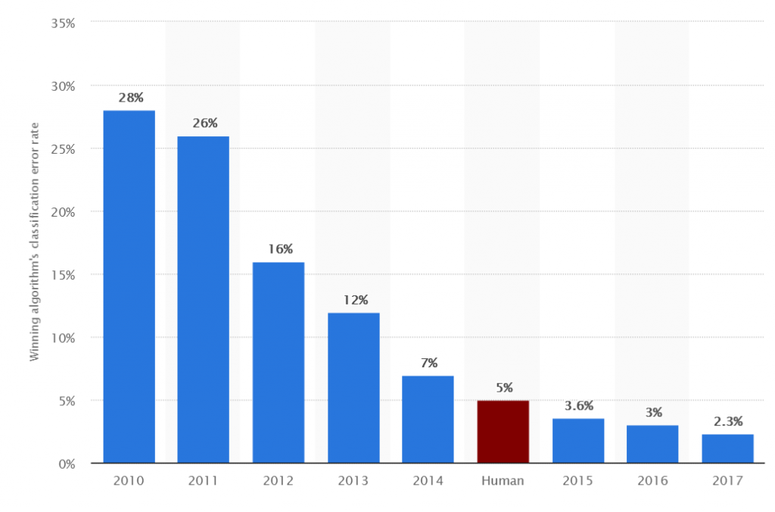
Computer Vision: Object Recognition
Image Classification: ImageNet Large Scale Visual Recognition Challenge (ILSVRC)
Szegedy, C., Ioffe, S., Vanhoucke, V. and Alemi, A.A., 2017, February. Inception-v4, inception-resnet and the impact of residual connections on learning. In AAAI (Vol. 4, p. 12).

Slide 10

Computer Vision: Object Recognition
Image Classification: ImageNet Large Scale Visual Recognition Challenge (ILSVRC)
Find a cat
Szegedy, C., Ioffe, S., Vanhoucke, V. and Alemi, A.A., 2017, February. Inception-v4, inception-resnet and the impact of residual connections on learning. In AAAI (Vol. 4, p. 12).

Slide 11
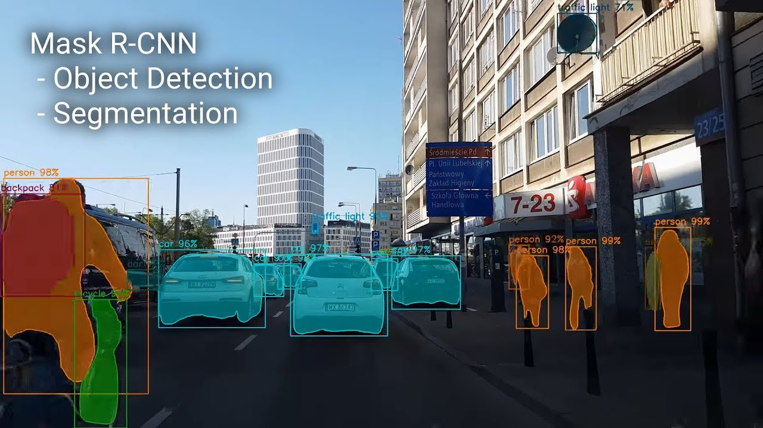
Computer Vision: Object Detection and Segmentation
He, K., Gkioxari, G., Dollár, P. and Girshick, R., 2017, October. Mask r-cnn. In Computer Vision (ICCV), 2017 IEEE International Conference on (pp. 2980-2988). IEEE.

Slide 12
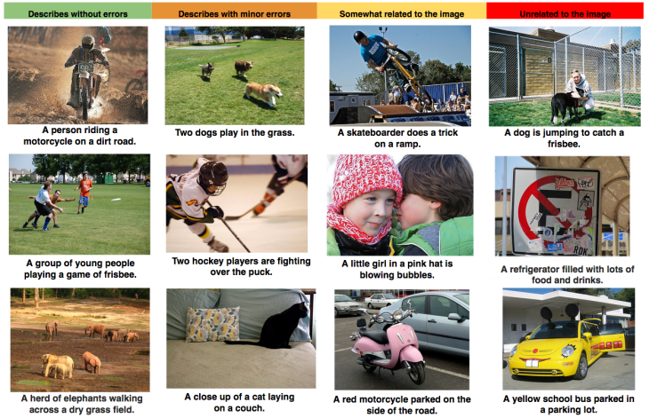
Computer Vision: Image Captioning and Question Answering

Slide 13
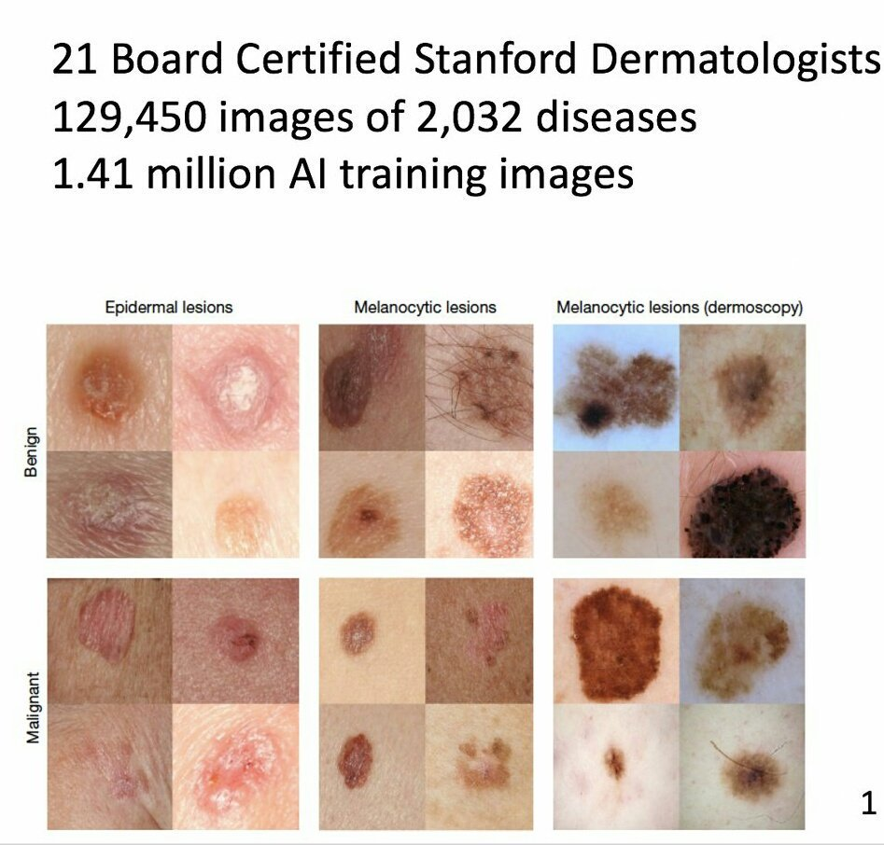
Medical Image Diagnostic
Deep Neural networks Perform Better Than Dermatologist for skin Cancer Detection
Esteva, A., Kuprel, B., Novoa, R.A., Ko, J., Swetter, S.M., Blau, H.M. and Thrun, S., 2017. Dermatologist-level classification of skin cancer with deep neural networks. Nature, 542(7639), p.115.

Slide 14
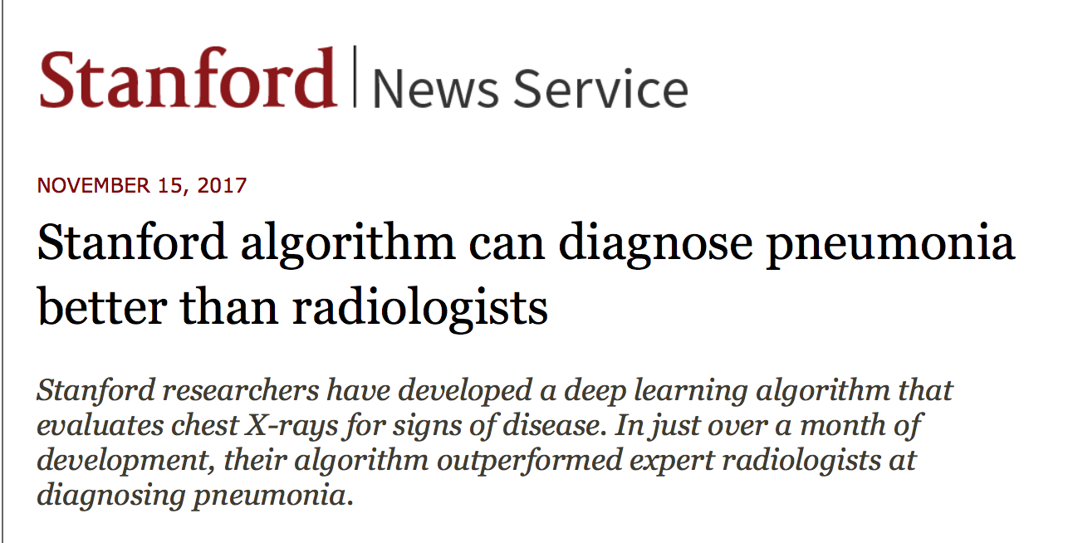
Medical Image Diagnostic
Deep Neural networks Perform Better Than Dermatologist for skin Cancer Detection
Esteva, A., Kuprel, B., Novoa, R.A., Ko, J., Swetter, S.M., Blau, H.M. and Thrun, S., 2017. Dermatologist-level classification of skin cancer with deep neural networks. Nature, 542(7639), p.115.

Slide 15
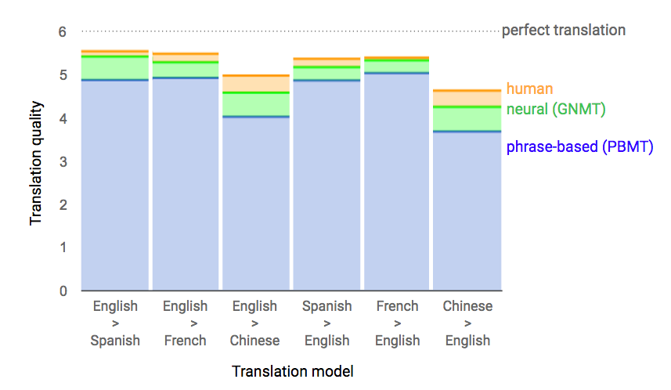
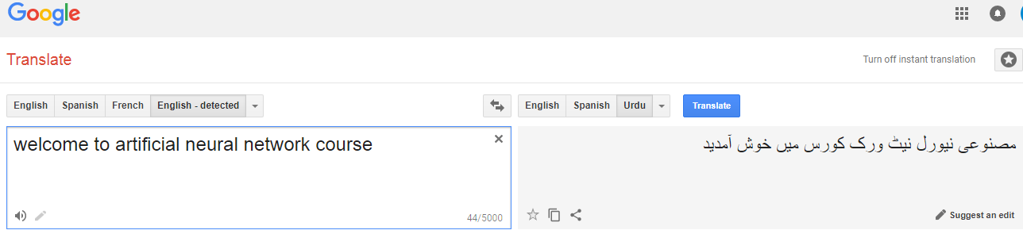
Natural Language Processing: Machine Translation
Machine Translation
Vaswani, A., Shazeer, N., Parmar, N., Uszkoreit, J., Jones, L., Gomez, A.N., Kaiser, Ł. and Polosukhin, I., 2017. Attention is all you need. In Advances in Neural Information Processing Systems (pp. 5998-6008).

Slide 16
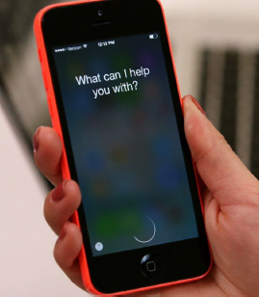
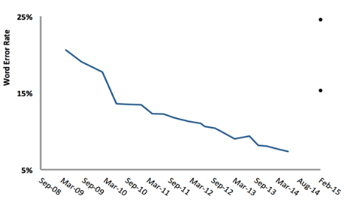
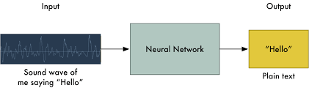
Natural Language Processing: Speech Recognition
Chiu, Chung-Cheng, et al. "State-of-the-art speech recognition with sequence-to-sequence models." arXiv preprint arXiv:1712.01769 (2017).

Slide 17
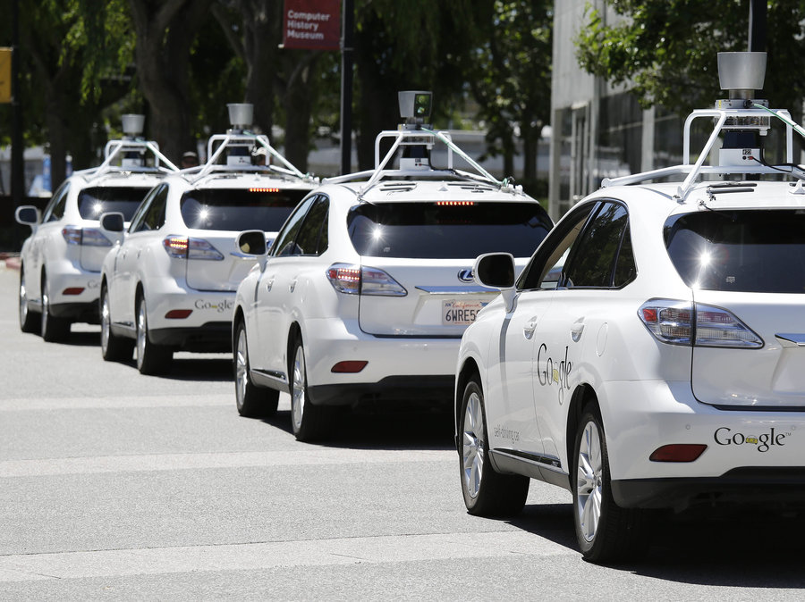
Why AI?: Self Driving Cars
In 2015, the US states of Nevada, Florida, California, Virginia, Washington D.C. allowed the testing of autonomous cars on public roads.
In 2017 Audi stated that its latest A8 would be autonomous at up to speeds of 60 km/h using its "Audi AI"
Notes:
Why Ai, It consists of a bunch of algorithms/ ideas that can solve certain types of problems which would not easily be dealt with otherwise. What is the essence of those applications: autonomy (freedom to act independently)

Slide 18
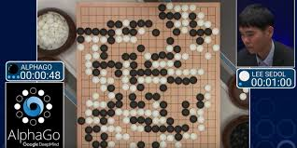
Why AI?: Games
It became the first ComputerGo program to beat a human professional player on a full-sized 19×19 board. In March 2016, it beat Lee Sedol in a five-game match.

Slide 19
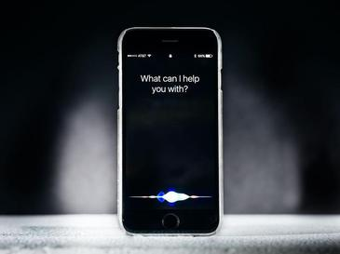
Why AI?: Virtual Personal Assistant
Siri, Google Now are intelligent digital personal assistants on various platforms (iOS, Android, and Windows Mobile). In short, they help find useful information when you ask for it using your voice; you can say “Where’s the nearest Chinese restaurant?”,
“What’s on my schedule today?”, “Remind me to call Jerry at eight o’clock,” and the assistant will respond by finding information, relaying information from your phone, or sending commands to other apps.

Slide 20
Why AI?
Medical : Many Surgeons now use robot assistants in microsurgery. E.g. HipNav
Humaniod Robot like ASIMO was designed to operate in real-world environments, with the ability to walk or run on two feet at speeds of up to 6 kilometres per hour (3.7 mph)
Information Retrieval: Search engines like Google and Yahoo uses AI for data retrieval
Computer Vision: OCR, face recognition (biometric, tracking)

Slide 21
Text Book and Course Material
Textbook: S. Russell and P. Norvig Artificial Intelligence: A Modern Approach Prentice Hall, 2003
Handouts and references of reading text will be provided in the class or before the class.

Slide 22
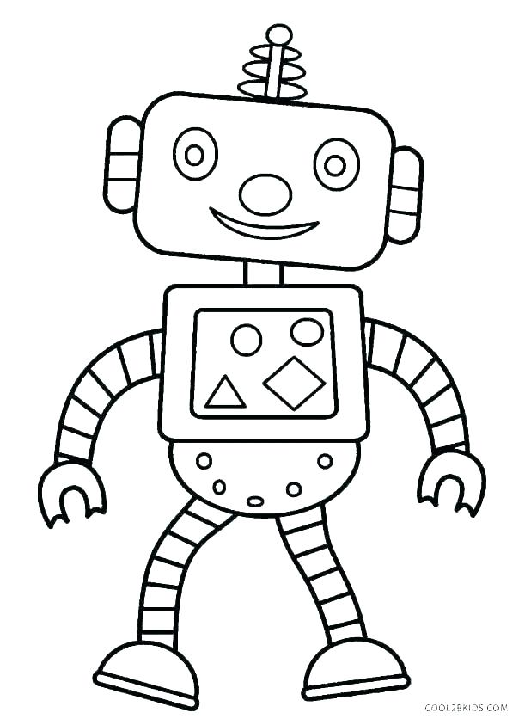
Advanced Topics in AI: Syllabus
Imagination: Deep Generative Models
Perception: Deep Convolution Neural Networks
Thinking: Deep NeuroSymbolic Reasoning and Probabilistic Decision Making
Language Processing: Deep Recurrent Neural Network
Control: Deep Reinforcement Learning
Figure Rational Agent

